Slide 1
Blue schools
PaedDr. Emil Jaroš
Lenka Kužmová
Samuel Bacák

Slide 2
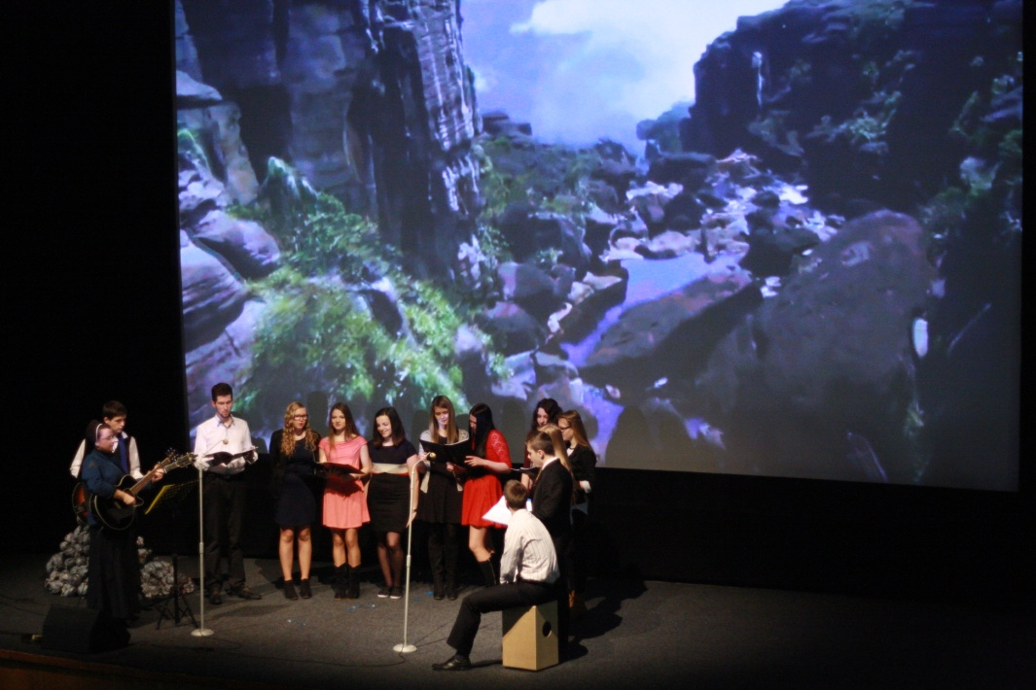
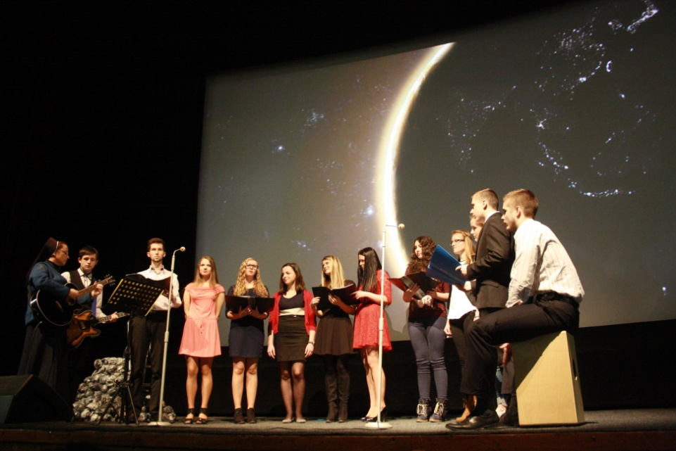
World Water Day on our school

Slide 3
March 24, 2015 the Secondary Grammar School of St. John Chrysostomos in Humenné reminded World Water Day.
This event took place in The Cultural Centre in Humenné and it was accompanied by a virtual video of Planet Earth and water.
We had invited public to this event by our poster.

Slide 5
The invitation was accepted by the Deputy Mayor of Humenné Ing. arch. Andrej Semanco and Mgr. Slávka Džačovská.
She explained us how would the world look without water 55 years later. We realized that the water must be protected!

Slide 6
Project objectives
At least 4 lessons will be taught about floods and draught preventions.
After installation of containers, 83% of school area will be disconnected from rain plumbing.
In school area there will be planted 12 trees and they will revitalize our school area.

Slide 7
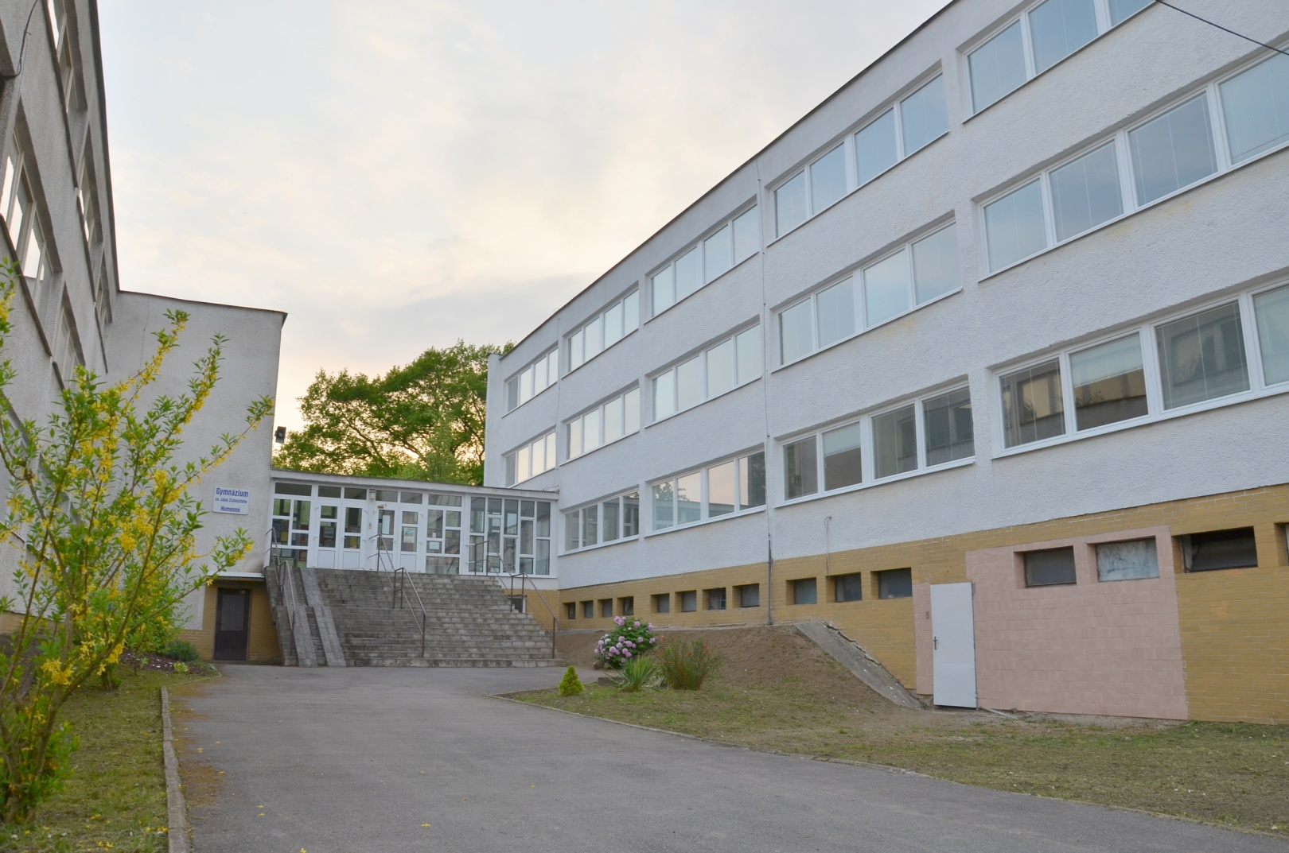
Our school area

Slide 8
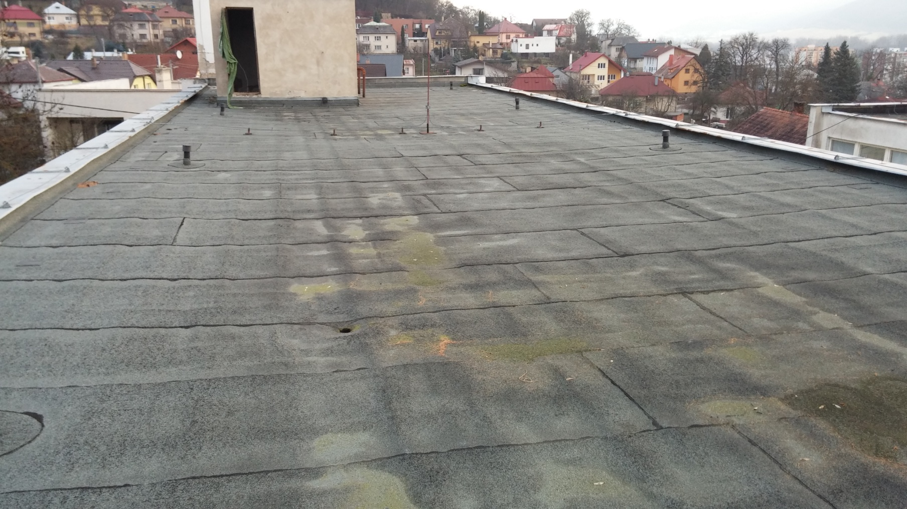
Our school roof

Slide 9
Thank you for you attention!

